Slide 1
The pan-tilt duck

Slide 2
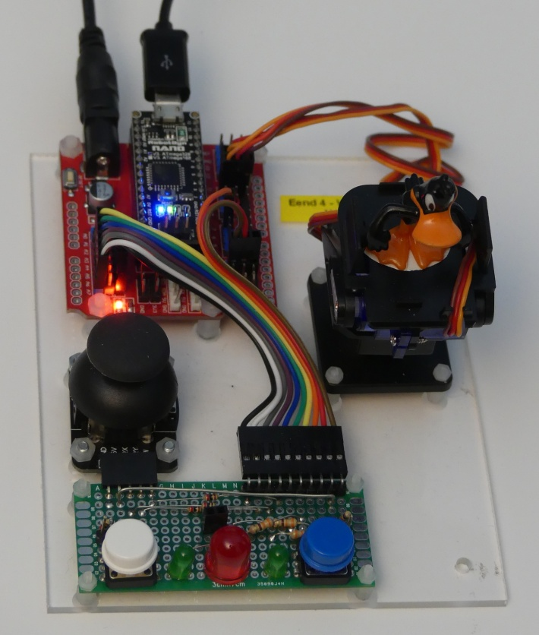
The setup
Arduino Nano which controls
Two servos (pan and tilt)
1 joystick
2 buttons
3 LEDs
The real control comes from a program in Scratch on Raspberry Pi which connects to the board via a program scratchClient.

Slide 3
Further presentation to be worked out.

